Slide 1
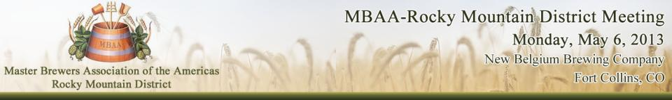

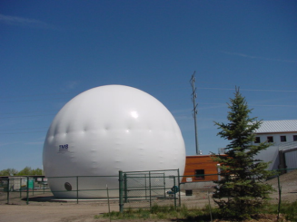
Process Waste Water Treatment
at
New Belgium Brewing Co.
Presented by Brandon Weaver
Process Waste Water Plant Lead Operator/
Mechanical Technician
Notes:
Welcome.
I’m going to talk about how one brewpub goes from brewing for across the bar consumption, to production and packaging.

Slide 2
Time line of construction and expansions
1995 - 2002 _ pH adjustment of process waste water
2002 - 2006 _ Two-stage system designed by Von Nordenskjold (German)
2006 – Present _ UASB and aerobic solids handling upgrades by Sanotec (Belgian)

Slide 3
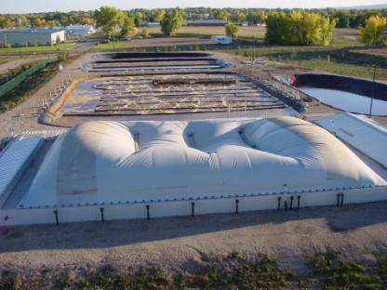
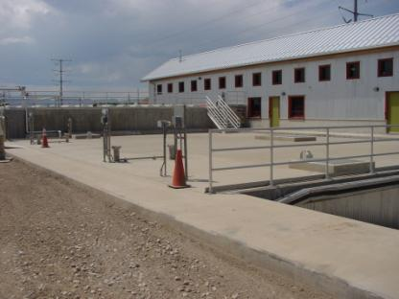
Phase two 2006
Sanotec
UASB reactor commissioned May 2006
Original anaerobic reactor 2002-2006
Reactor 800 cubic meters
Anaerobic reactor 1500 cubic meters
Holding basin 430 cubic meters
Two holding basins 600 cubic meters each

Slide 4
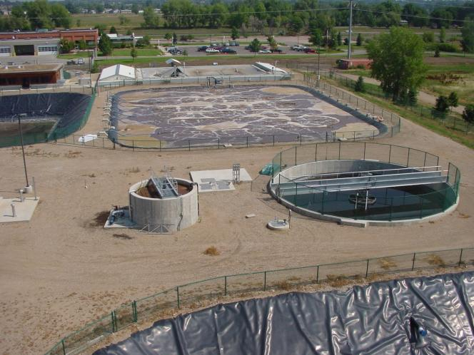
upgraded aerobic clarifier
may 2006

Slide 5
New Belgium production history
PWTP phase one
PWTP phase two

Slide 6
Current loading
Entire plant
UASB
Volume – 660 m3/day 174,350 gpd
Inlet COD – 4,600 kg/day 10,185 lbs./day
Outlet COD – 39 kg/day 86 lbs./day
Outlet BOD – 3 kg/day 7 lbs./day
Volume – 660 m3/day 174,350 gpd
Inlet COD – 4,600 kg/day 10,185 lbs./day
Outlet COD 386 kg/day 851 lbs./day

Slide 7
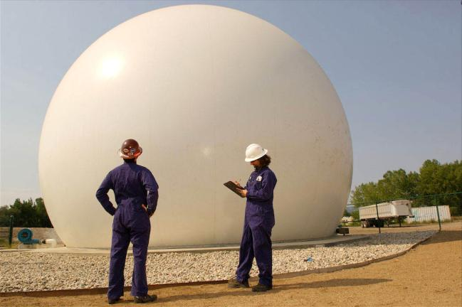
Biogas usage

Slide 8
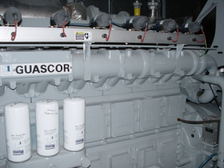
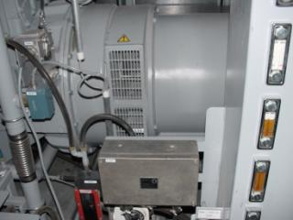
Biogas
75% methane
24% CO2
800 – 1,000 ppm H2S
Utilization
  500 kw Combined heat and power unit at brewery
  292 kw generation unit at pwtp
  480k BUT boiler for original pwtp building

Slide 9
New Belgium’s hop situation
- A dramatic increase in the amount of hops used at the brewery caught us off guard and slowly overwhelmed the UASB.

Slide 10

Our original dry hops removal process

Slide 11
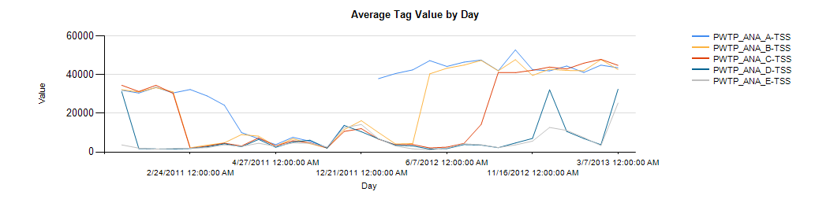
Dry solids measurement in
UASB

Slide 12
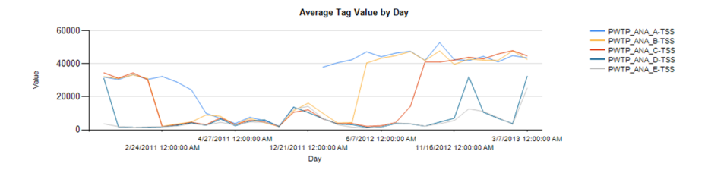
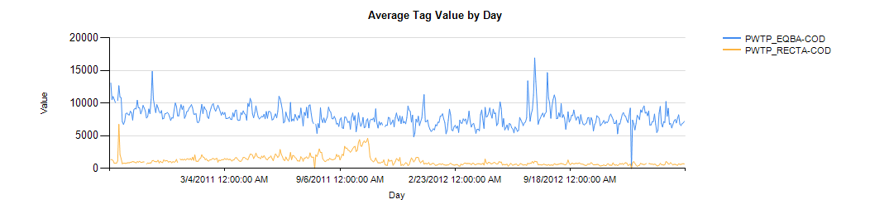
COD removal through digester

Slide 13
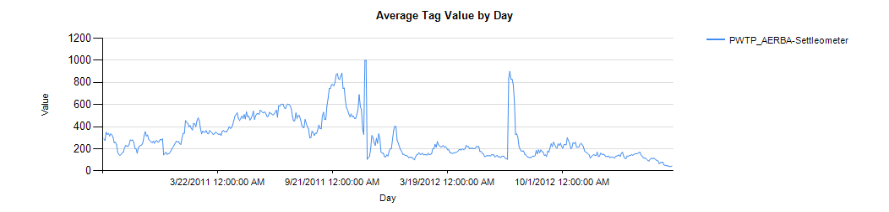
Downstream effects on aerobic settling

Slide 14
Control over the waste stream
- although as waste water operators, we tend to avoid “the tail wagging the dog,” there are instances where pushing back can benefit the entire organization.
- correcting this problem that at first, appeared to be just a “waste water” issue, had several unforeseen benefits.

Slide 15
The Solution

Slide 16
Benefits
- immediate increases in health and performance at the pwtp.
- no longer having Roto Rooter on-site several times a week for drain clogs.
- cellar operators can focus on tasks other than floor and drain cleanup.
- ~15% increase in beer quantity from each dry-hopped tank by centrifuging the entire contents of the tank!

Slide 17
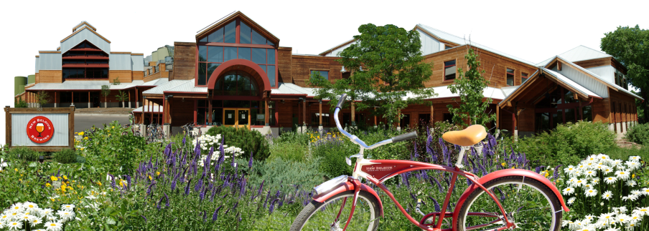
Thank You

